Slide 1
Test Automation
Team 7 - Cloud 9

Slide 2
Team Members
Benjamin Ellis
Alex Reel
Camron Savage
Alex Tanner
Patrick Yoder
Yankai Zhao

Slide 3
Presentation Overview
Project Overview
Architecture and Design
Testing Process
Metrics
Quality Review Results
Lessons Learned
Conclusion

Slide 4
Project Overview
Customer: Ben Fox - Trissential
Needs:
Create a functional ecommerce webstore
Admins can toggle the appearance of specific bugs in the store
Admins can toggle bugs on a per-user basis
Purpose:
Train users to write automated test scripts
Evaluate how employees check for edge cases and bugs

Slide 5
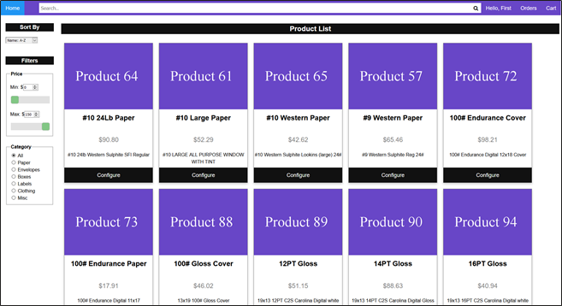
Project Overview (cont.)

Slide 6
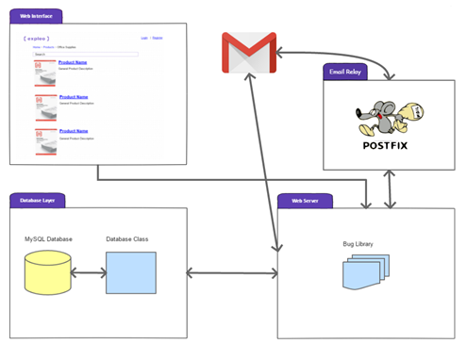
Architecture
Legacy Architecture
Four major components:
Web server with bug library
Storefront content
Database interface
Email relay

Slide 7
Architecture (cont.)
New Methods for Storefront
Wishlists
Re-Orders
Multiple Addresses
Store Administrators
Promotional Codes
Store-Wide Discounts
Additional bugs for all methods
Legacy Methods for Storefront
Registration / Login
Search / Filter
Product List Display
Database
Order History
Cart
Checkout
Admin Functionality
Bug Framework

Slide 8
Testing
Will be performed manually and consist of both integration and unit testing.
Focus areas are:
Ensuring proper styling.
Verifying bugs work as expected and only when assigned.
Verifying the application interacts properly with database

Slide 9
Metrics
Adding on to a previous project, so story points are additions to that base
Highest story points to be added (scale 1-10):
(8) Add wishlist functionality
(8) Add multiple types of users (high-level administrator, store administrator, basic user)
(7) Add bugs for new functionalities
(6) Improve website aesthetics

Slide 10
Quality Review
Most work so far has been organizational, planning, or getting the project running on our machines
Email verification not documented by previous group
No automated tests written by previous group

Slide 11
Lessons Learned
Probably didn’t need as much time spent planning
Projects with a lot of documentation < Projects with good documentation
Dividing work and knowing who will be working on what has been helpful so far

Slide 12
Conclusion
We expect success in building off of the previous project in place
We will
Add new bugs, new functionalities, and update the aesthetics of the ecommerce site
Make it easier for the customer to interact with the bug-loading platform

